Slide 1
Business Focus out come Plan

Slide 2
Business Goals
Deliver a Seamless User Experience: Ensure intuitive navigation, fast loading times, and a responsive design to provide users with a hassle-free shopping experience on any device.
Build Trust and Credibility : Showcase professional design elements, customer reviews, secure payment options, and transparent policies to establish trust with customers and encourage repeat business.
Maximize Sales and Revenue : Implement data-driven marketing strategies, such as personalized recommendations, discounts, and promotions, to increase conversion rates and customer lifetime value.
Expand Market Reach : Leverage digital marketing channels, including social media, email campaigns, and SEO, to attract a wider audience and establish a strong online presence in the competitive marketplace.

Slide 3
Market Research
Competitors: Daraz, Naheed, ELO Shopping
Weak Points:
Daraz:
Overwhelming product variety may confuse users.
Long delivery times for non-local sellers.
Inconsistent customer service experiences.
Naheed:
Limited product categories compared to broader e-commerce
platforms.Lack of mobile app features for enhanced shopping
convenience.Minimal online presence beyond its niche market.
ELO Shopping:
Smaller product inventory limits customer choice.
Relatively lower brand recognition in the competitive market.
Basic website design with limited advanced features, such as personalized recommendations.

Slide 4
Target Audience
Age Group: 18-45 years, with a secondary focus on 45+ seeking convenience.
Demographics: Middle to high-income individuals, including professionals, homemakers, and students.
Geographic Focus: Urban and semi-urban areas with internet and delivery access.
Behavior: Tech-savvy shoppers prioritizing quality, affordability, and quick delivery.
Psychographics: Value convenience, competitive pricing, and trusted sellers.

Slide 5
Data Schema Draft

Slide 6
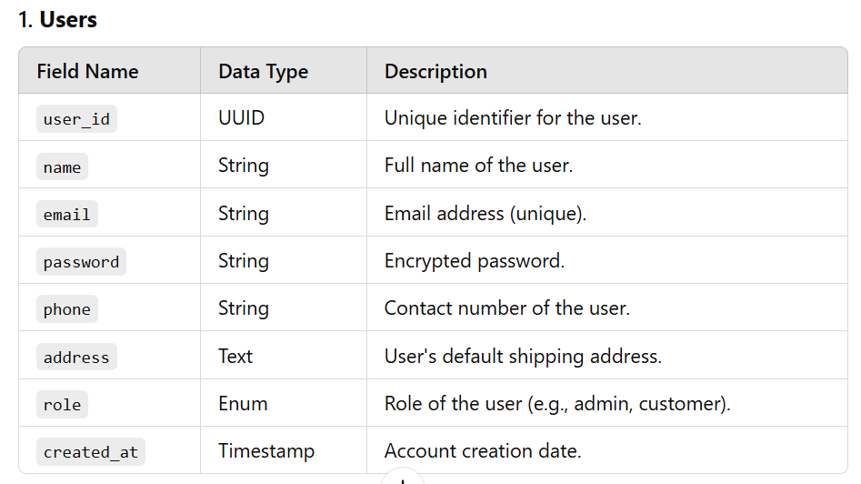

Slide 7
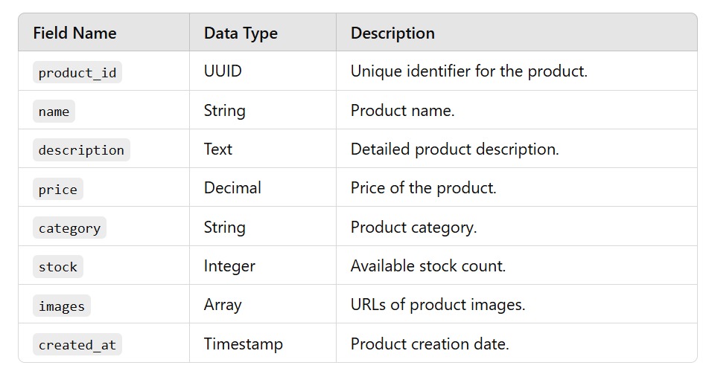
2. Product

Slide 8
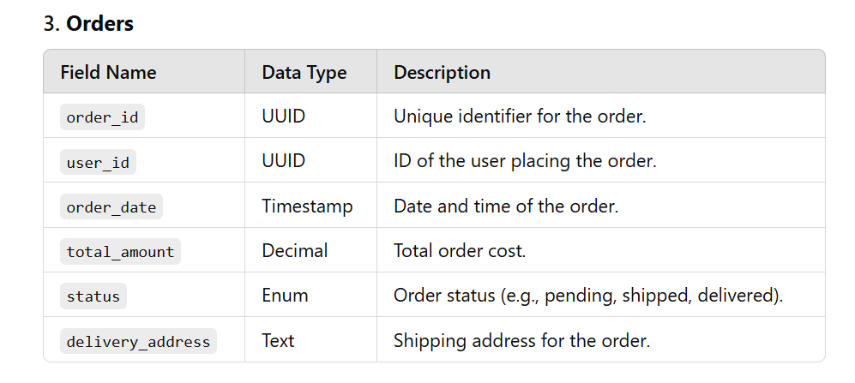

Slide 9
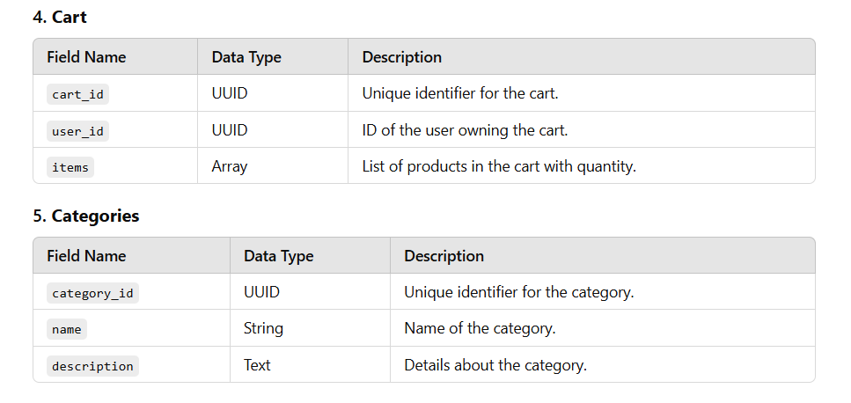

Slide 10
